Slide 1
FIE
H^o |_AnG

Slide 2
关于小男孩
郝朗
我想从爸爸说起。记得我很小的时候，爸爸在家后院修建了一个微型的小花园，种上了各种各样精 心修剪过的盆栽，放学回家经常能见到爸爸在摆弄他的那些宝贝。根雕（用树木的根做成工艺品） 也是他钟爱的，印象中的爸爸，穿着围裙，手里面拿着各式各样的工具，打磨，雕刻着从各地收集 回来的树根。我想他的这些兴趣爱好对我走上艺术这条路有着潜移默化的影响。
于是七八岁的我放弃了拉小提琴，写毛笔字，练体操这些当时父母常为孩子设计的补习项目，拖着 妈妈选择了小县城里一位老艺术家开办的绘画兴趣班。老人家性严，我们亲切的叫她严婆婆，她也 算是我的艺术启彖老师。在她耐心的指导下我开始用水彩笔在小小的国画本上描绘童年的幻想世 界。她总夸赞我画画得不错，是画画的料，在父母面前更是赞不绝口，严婆婆给了我很大的信心， 以至于大人们问起我的理想时，我都会说长大要当个画家！
初高中时，因为有一定的美术基础，每当美术课结束，总会收到十几二十本美术作业让我帮忙画， 我倒也乐此不疲。黑板报也理所当然的变成了我的职责范围。
考大学时因为文化成绩中等，我顺理成章地选择了读艺术大学，并且非常幸运地以最后一名考进了 四川美术学院油画系。曾经有很长一段时间我都很自卑，因为专业水平非常不好，基础素描一塌糊 涂，速写也从来都不会画。
大二的时候油画系分工作室，架上和综合材料工作室，我毫不犹豫地选择了后者。在综合材料工作 室我学习到了摄影，摄像，行为艺术，装置等等，我豁然开朗，慢慢地了解到不同材料语言可以任 意地表达思想。于是我急切地寻找着一种最适合自己的艺术表达方式……
直到我遇到了他——奈良美智。在他的笔下有着古灵精怪眼神的小女孩、洁白驯良的狗以及身着动 物外套的儿童，非常可爱。眼中流露出不友善的神情，加入了一丝玩世不恭的味道，同时又身处在 寂寥、淡漠背景中的画作主角们，让人不禁由怜生爱。我陶醉在这种卡通形式的作品当中。从小我 就对卡通情有独钟，《七龙珠》《阿拉蕾》《机器猫》《乱马》这些漫画书陪我度过了多少懵懂岁 冃。卡通也能作为一种形式来表达自我，通过这种载体把想法转换到画布上，于是我慢慢尝试着像 奈良美智那样创造自己的卡通风格。
于是我在生活中如饥似渴地寻找着创造这种卡通风格的灵感。一部电影，一张图片，一首歌的歌 词，都会变成创作的源泉。

Slide 3
妈妈从小就教育我要爰整洁，这种影响也渗透到了我的作品里。从我的草稿，作品，到生活的各个 细节都喜欢干干净净，工工整整。最开始我不喜欢自己的这种偏执，但是慢慢的觉得这种偏执也可 以变成一种冈格。
我的创作有很大一部分是实验性的，这和我在综合材料工作室的学习经历有关，我喜欢在画面上尝 试各种新的材料。从最开始塑型膏堆砌，布料的拼贴到后来用线在画面上缝制，金箔，金粉的应 用。我觉得对绘画材料本身的尝试就像做化学实验，是非常有意思的，因为你不知道实验的结果是 什么样子，但是会享受做实验这个过程。这个过程里面需要各种探索，都是为了达到最终想要的效 果而去努力。
最后谈谈这次的个展标题——《初吻》。缘起我的一张小作品，画面中有一个男孩的背亮，另一个 男孩勾住了他的脖子，手扶着他的脸庞，并深深地亲吻了下去，虽然看不到他们的脸，但是却能感 受到他们的羞涩，从男孩手上长出的小花月来看，心中一定萌芽出了爰情……
或许你已经发现，这个小男孩是多么的与众不同，但是他非常真诚，■良,他不懂得怎么把自己的 痛苦、欢喜和悲伤用言语表达，于是他就画，用小小的笔一笔笔的勾勒出自己的生活点滴和所有情 绪，希望通过画面得到人们的理解和爰……
两年时间，30张大大小小的画，生活的点点滴滴，爰。
About A Little Boy
Hao Lang
I would like to begin with my father. When I was a little boy, my father built a small garden in the backyard, and filled it with various carefully potted plants. A
new routine that became part of my life was to come and find my father tending
his potted treasures. Bedecked in an apron with the tools in hand my father
practiced the ancient alchemy of root carving shaping each one into a work of art.
(Root-carving， an art form using the roots of trees.) I feel it was my father that
gave me inspiration to grow and craft my works of art which define my life.
When I was around seven or eight years old, I refused to attend voila, calligraphy and gymnastics classes, they were the most commonly approved after-school activities of the time. I pestered my mom into taking me to an old artist that I came to call Grandma Yan. She was an artist who was teaching a painting class, and Grandma Yan is the first person who showed me the world of art. Under
her patient tutelage, I began to develop my world in small sketch books, with
watercolor pens. Grandma Yan always offered me praise saying that I show the
talent to be a painter. In addition she would always share her praise of my skills
to my parents when they would visit; this filled me with such confidence that when
I was asked about my future I would always answer with great confidence "I WILL
BE A PAINTER.
Due to my natural artistic talents, my classmates in middle school would always
seek me out for assistance in their art homework, which I always enjoyed. My talents also led to me being in charge of making of my classes display board.
Before I had even taken the university entrance exams I had already determined
that I would apply to attend an academy of fine arts in China . The main
determining factors were that my grades in other courses were mediocre and
my paintings were exceptional. I was finally blessed with acceptance to seek

Slide 4
admittance to the Sichuan Art Institute. Despite my initial adulation at acceptance to this prestigious institute, my ego was soon dashed when I realized that my classmates far exceeded me when it came to sketch techniques.
During your sophomore you have to decide which primary art medium you will enter; you are given a choice between oil painting and mixed media studios. I chose the latter with-out any hesitation; we learned photography, videography, performance, installations etc. This branch helped me to learn the different languages of art.
I finally found my key inspiration in Yoshitomo Nara. His works present figures of little girls with bright child-like eyes to dogs with eyes of a docile nature
never prevents you from having a good time when doing it.
Finally I would like to discuss the title of this exhibit： "First Kiss." This also
happens to be the name of one of my works, from the viewer's perspective you
see two boys from behind in a passionate embrace kissing each other deeply while
one cradles the head of the other. Although you cannot see their faces you can
feel their emotions, their shyness, tenderness and growing love between them. We
see this as a budding plant upon one boy's hand.
As you can see here I am not like other people, but I cannot tell people my
feelings through words. So instead I express these feelings through my paintings
presented in pure white. He even presents children wearing animal cosplay that are amazingly cute but yet presented in a lonely dim background promoting sympathy in the viewer. Since childhood I have been greatly fascinated by cartoons everything
to share with my audience the experiences of my life. From every brush stroke to every drop of paint they represent my feelings and emotions. All I seek through my
works are the love and appreciation of my audience.
from: Dragonball to Doraemon and Rama V2. Comic books also played a major role in my life at this time as they helped to get through my youth. I soon realized that
Two years of time, thirty big or small paintings, every small daily happening of
life, all about love.
cartoons presented a way to express my feeling through, and this realization is all
thanks to Yoshitomo Nara.
I constantly strive to express the inspirations that I receive in daily life through my
cartoons. This inspiration can come from a person I see on the street, a song or
even a movie.
From a young age my mother taught me to be neat, the result has shown an influence in my works. It does not matter if it is a draft or finished work they all
must be clean and tidy. In the beginning I resented that, until I determined it had become my style.
A majority of my works I consider experimental, which is drawn from my days of studying mixed medium arts. It was in the mixed arts I tried new mediums in my paintings; everything from piling of plastic paste, collage cloth and gold leaf and powder. I feel the exploration of different mediums is as exciting as chemistry
experiments. From the beginning you never know the results until the end, but this

Slide 6
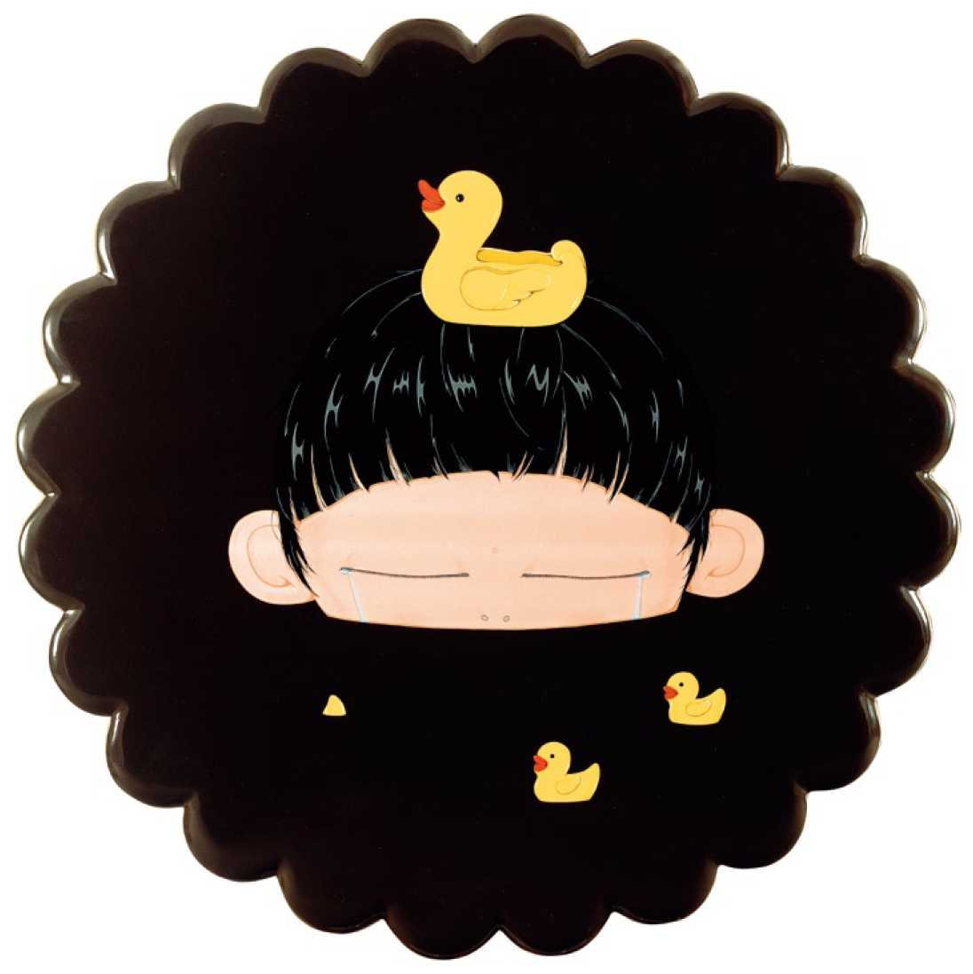
哭到淹没了自己
Flood Myself With Tears
①120cm
玻璃钢丙烯着色
Fiber reinforced plastic with Acrylic
2008
1 1

Slide 7
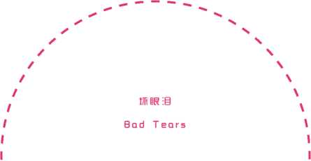
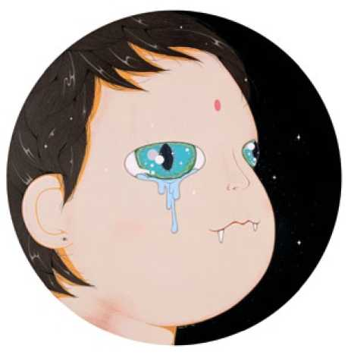
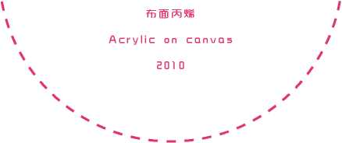
① 50cm
13

Slide 8
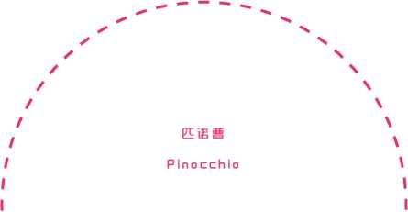
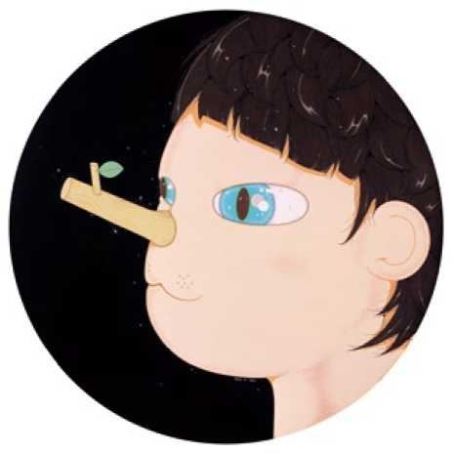
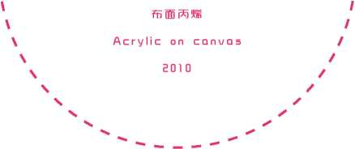
① S0UE
15

Slide 9
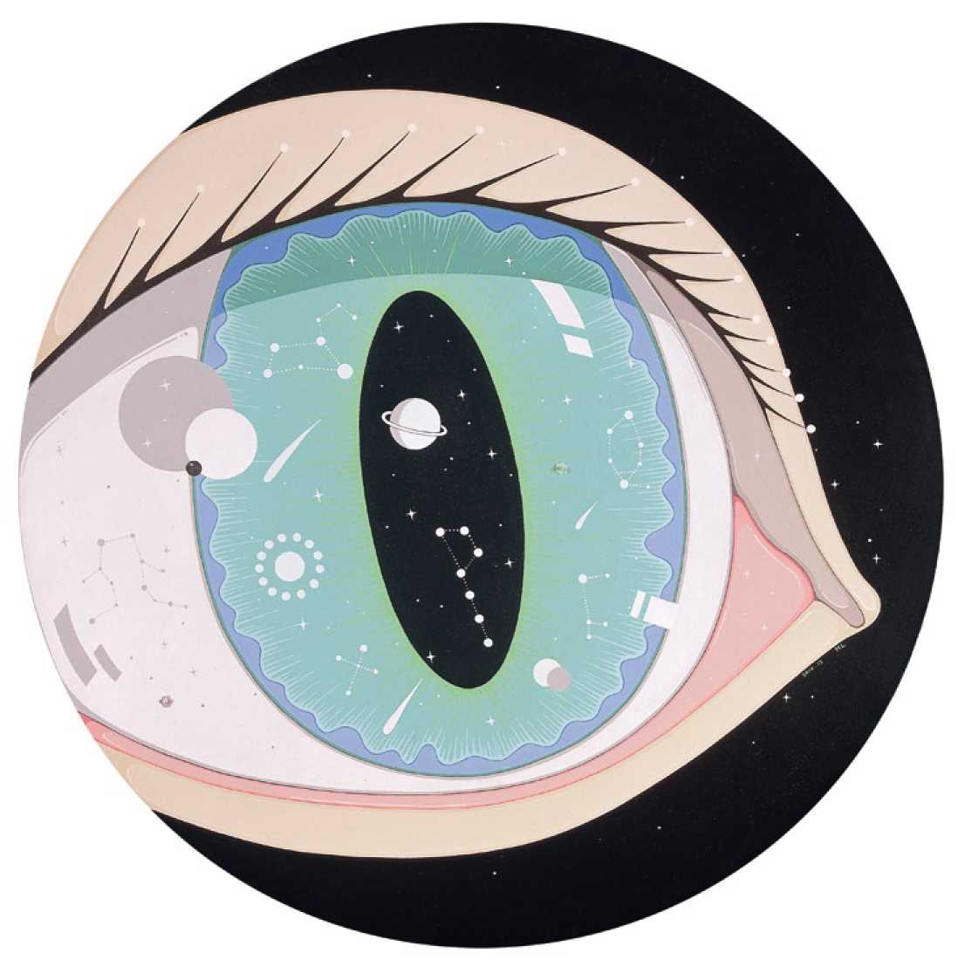
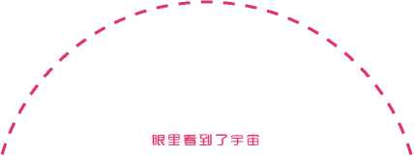
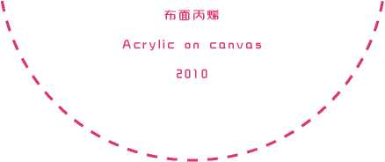
I Saw the Universe in the Eye
① 50cm
17

Slide 10
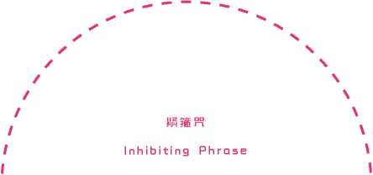
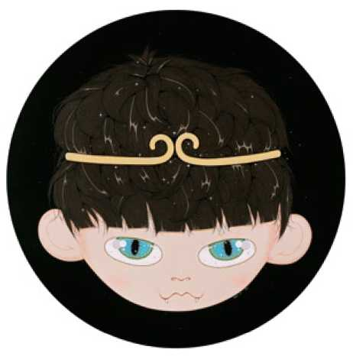
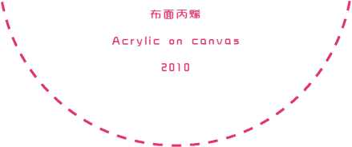
① 50cm
19

Slide 11
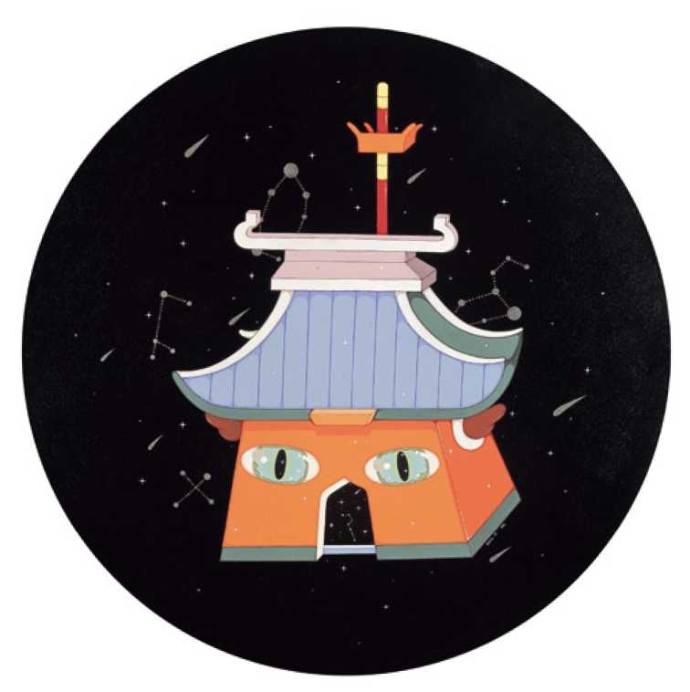
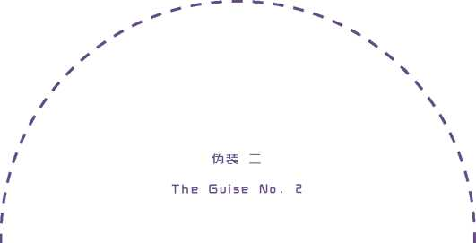
①60cm
布面丙烯
Acrylic on canvas
2010
21

Slide 12
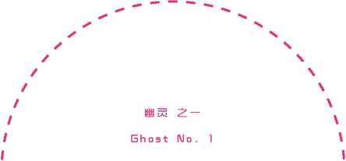
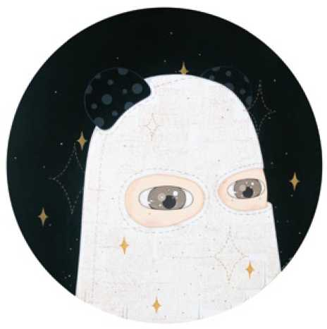
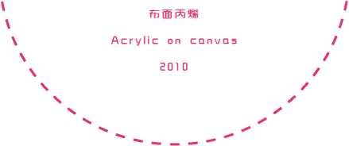
① 50cm
23

Slide 13
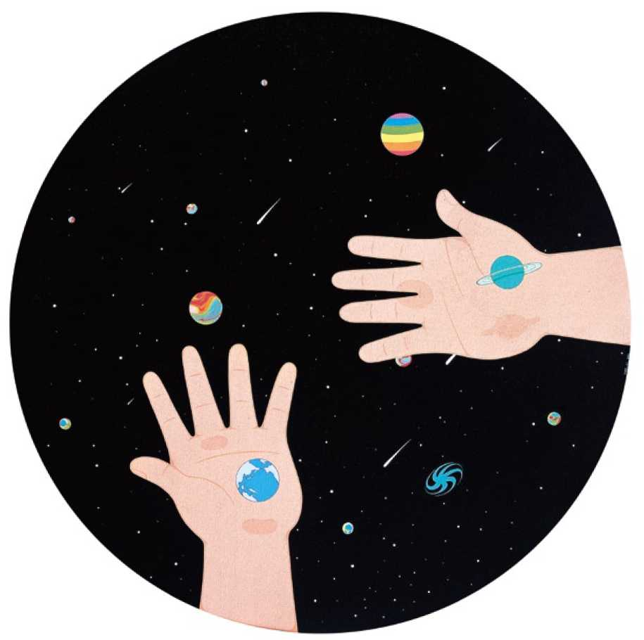
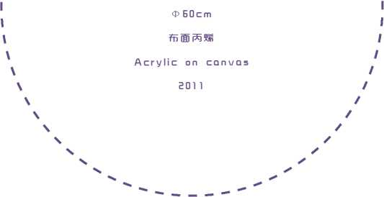
手心及宇宙
The Palms and th e Universe
25

Slide 14
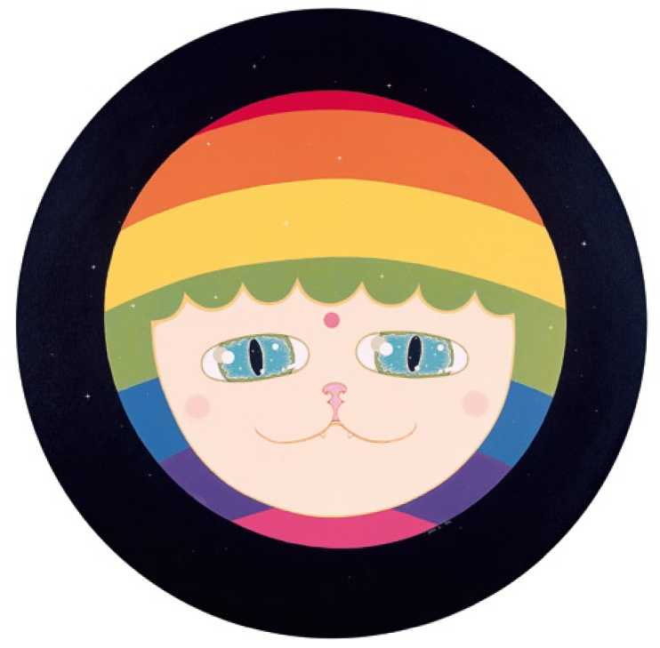
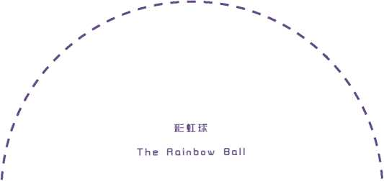
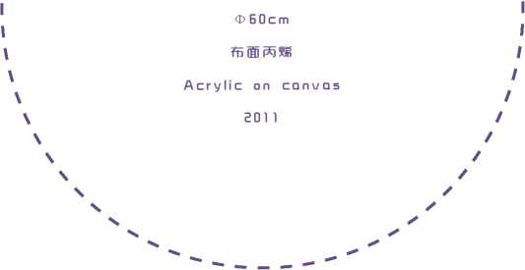
27

Slide 15
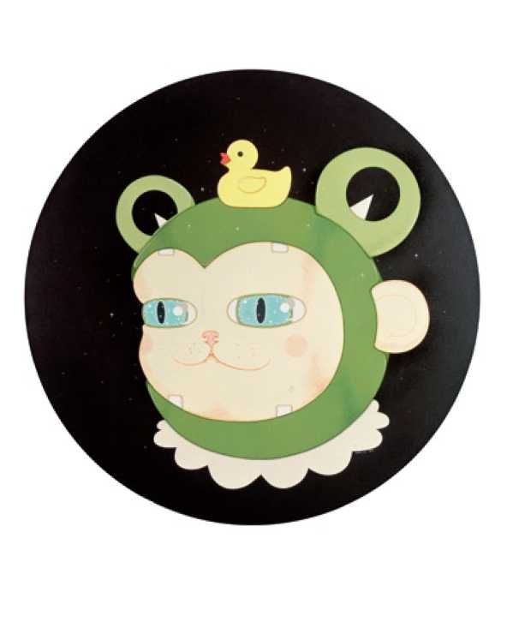
One day I Will
有一天，带着我的小鸭子去流浪
Rove With My Little Duck
O60cm
布面综合材料
Mixed media o n canvas
201 1
29

Slide 16
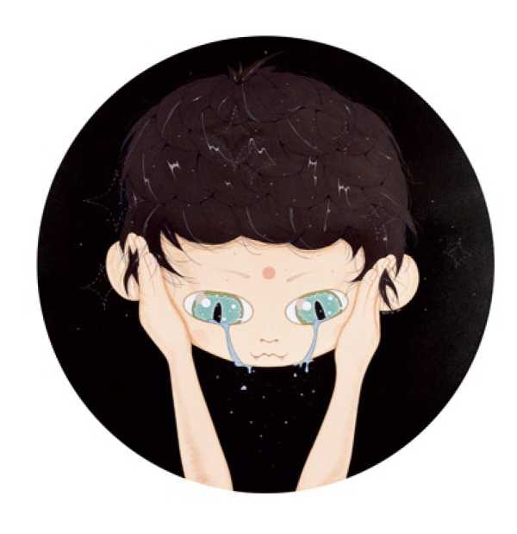
好眼泪
Good Tears
①60cm
布面综合材料
Mixed media o n canvas
201 1
31

Slide 17
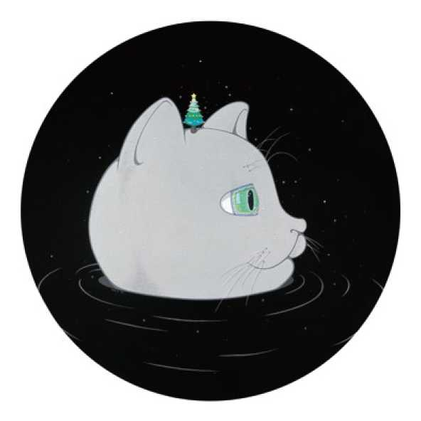
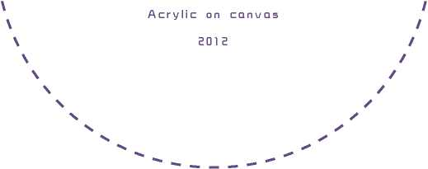
你是否还爱我？之一
Do You Still Love Me? NO. 1
① 60cm
布面丙烯
33

Slide 18
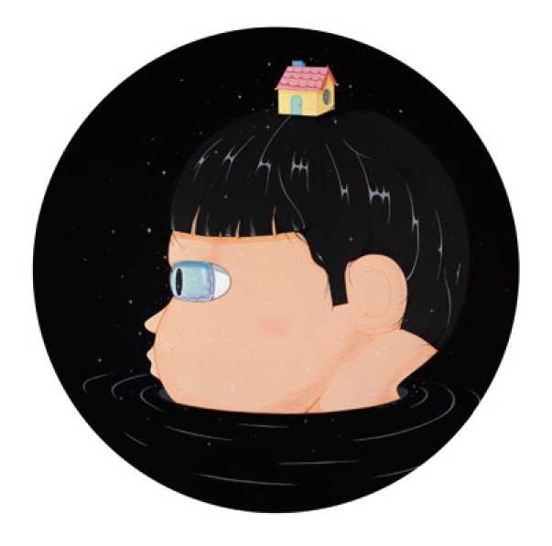
你是否还爱我？之二
Do You Still Love Me? NO. 2
① 60cm
布面丙烯
Acrylic on canvas
2012
35

Slide 19
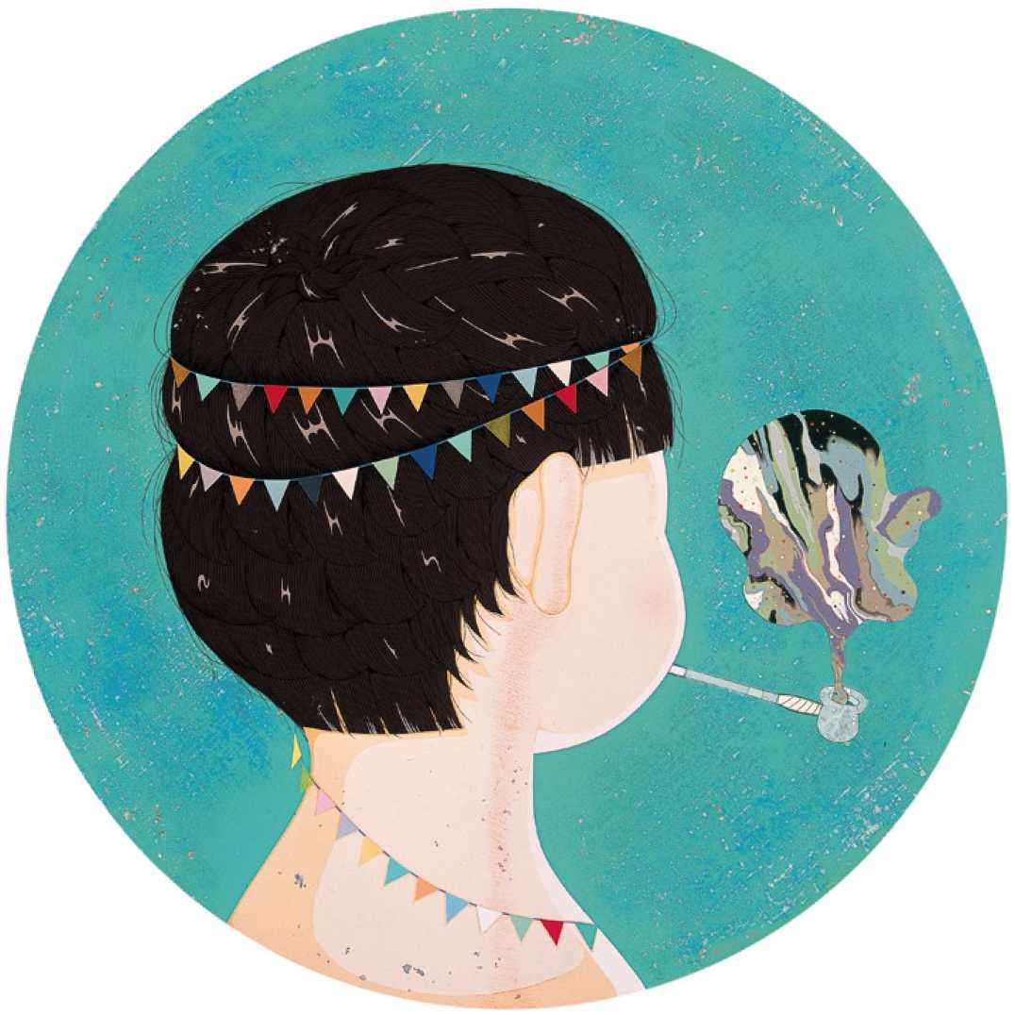
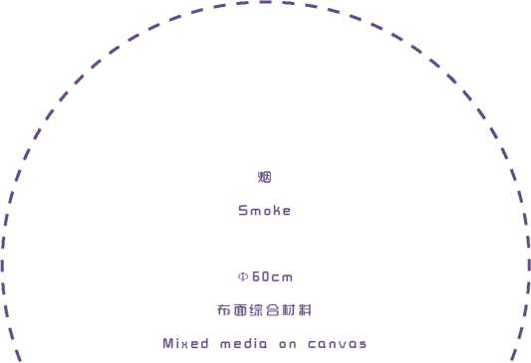
2012
37

Slide 20
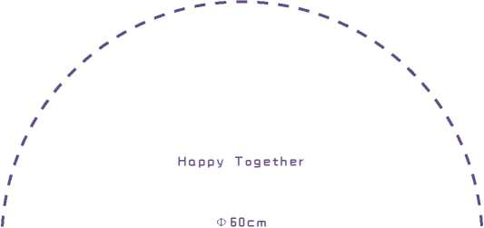
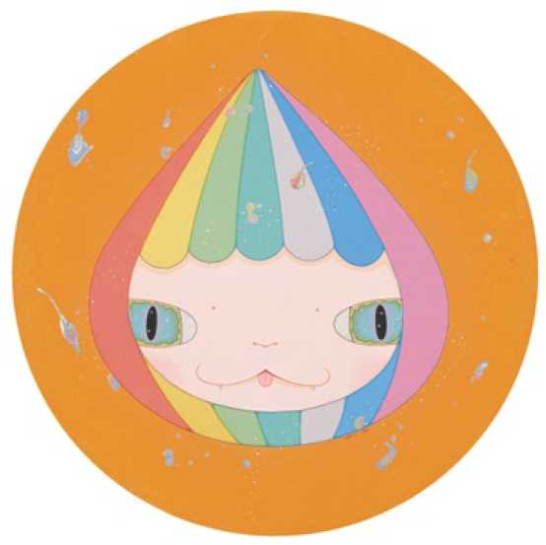
布面综合材料
Mixed media o n canvas
2012
39

Slide 21
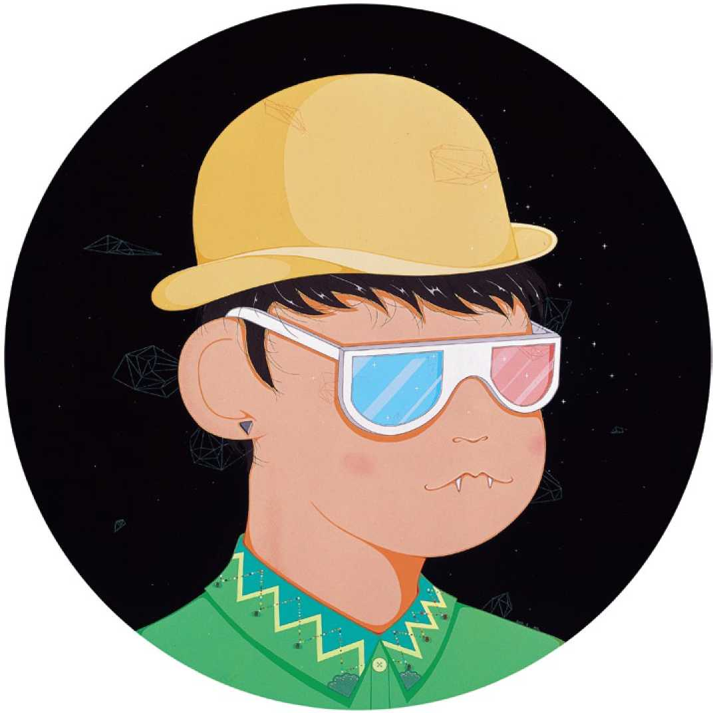
自画像
Self-portrait
① 80cm
布面综合材料
Mixed media on canvas
2012
41

Slide 22
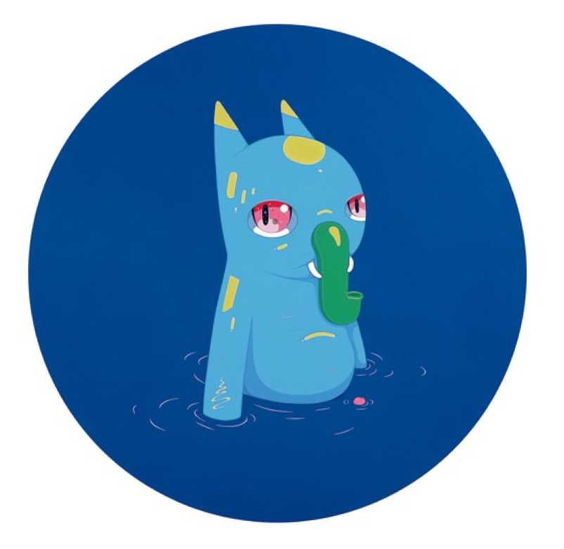
43

Slide 23
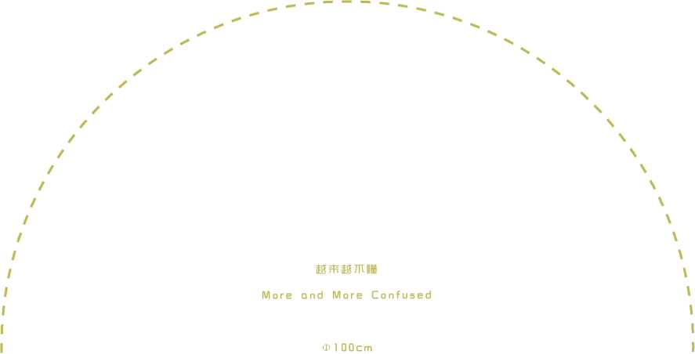
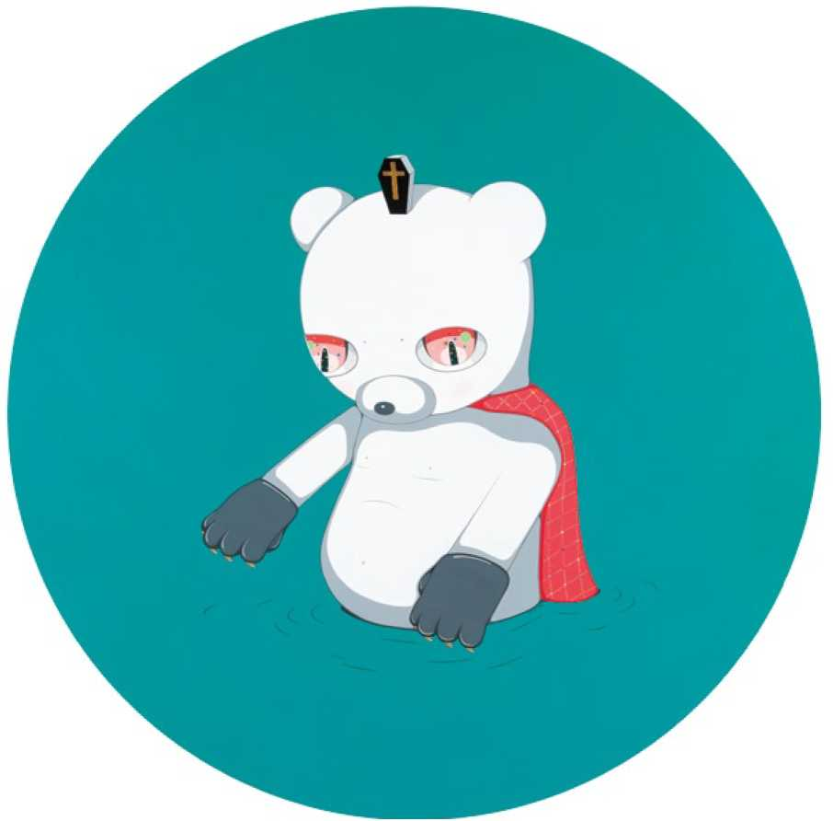
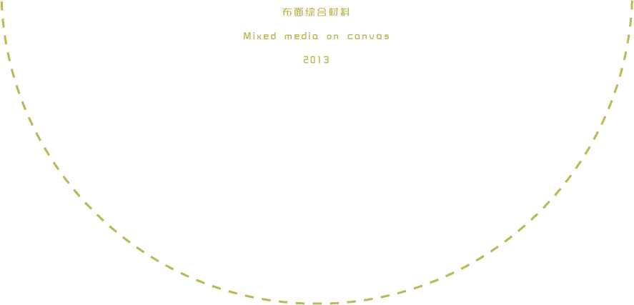
45

Slide 24
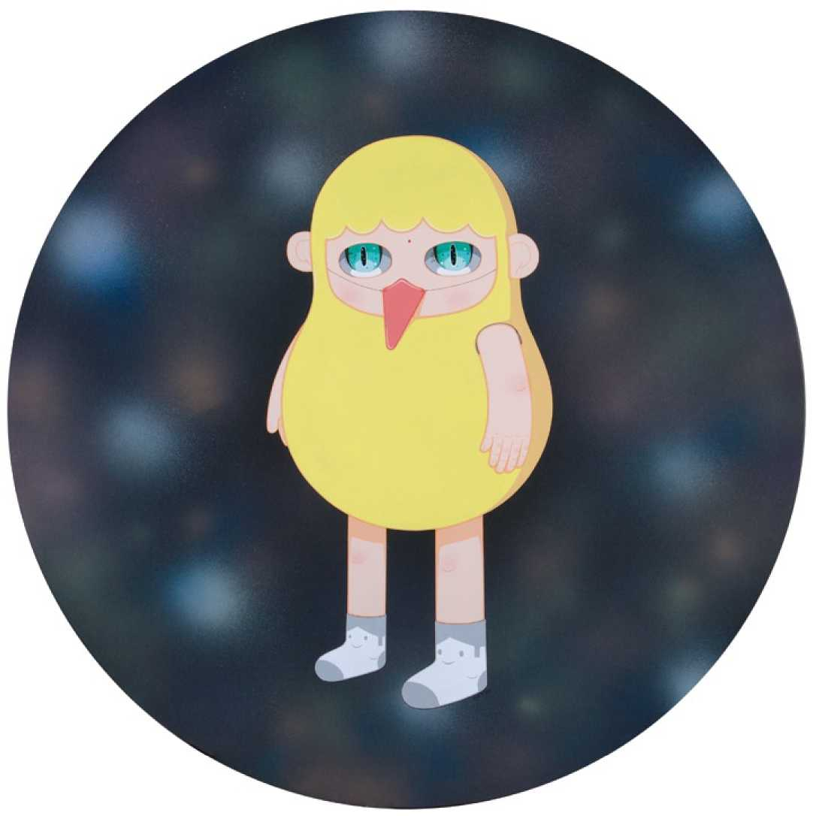
47

Slide 25
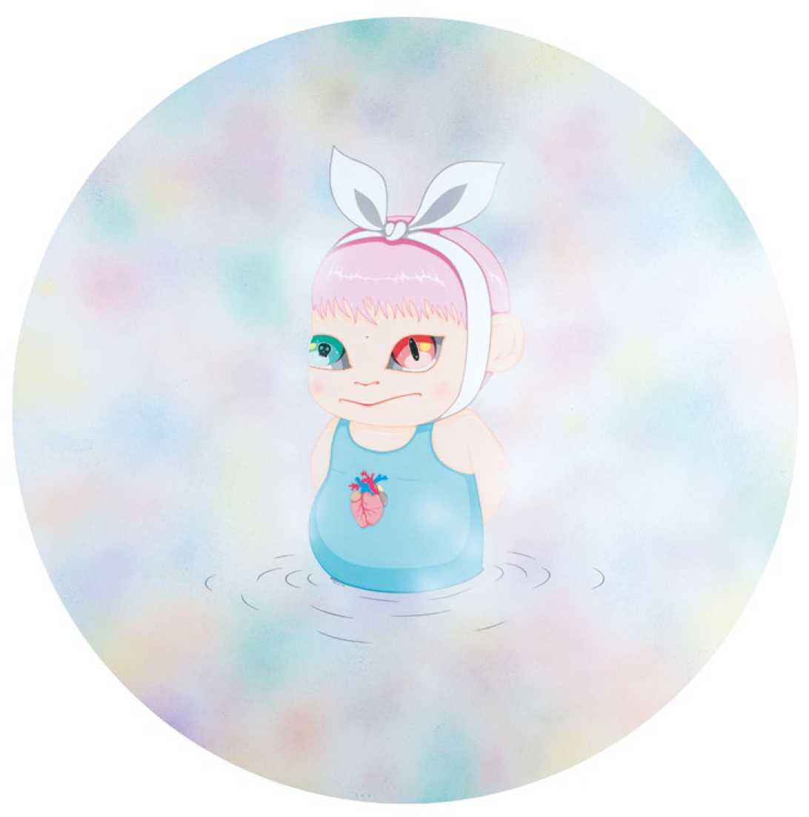
如果发现什么秘密，爪要告诉任何人之一
I f you find a secret, Don't tell anyone! No . 1
① 1 20cm
布面丙烯
Acrylic on canvas
2013
49

Slide 26
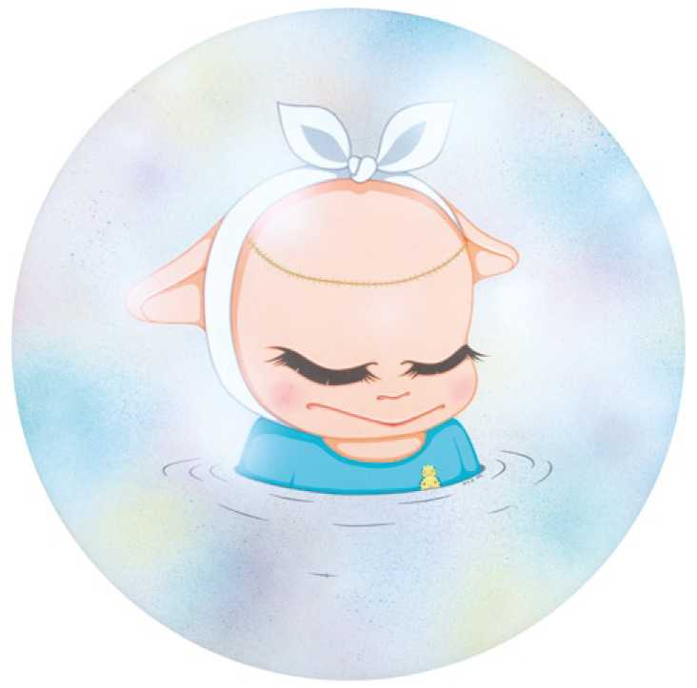
如果发现什么秘密，爪要告诉任何人之二
If you find a secret, Don't tell anyone ! No . 2 ① 60cm
布面综合材料
Mixed media o n canvas
2013
51

Slide 28
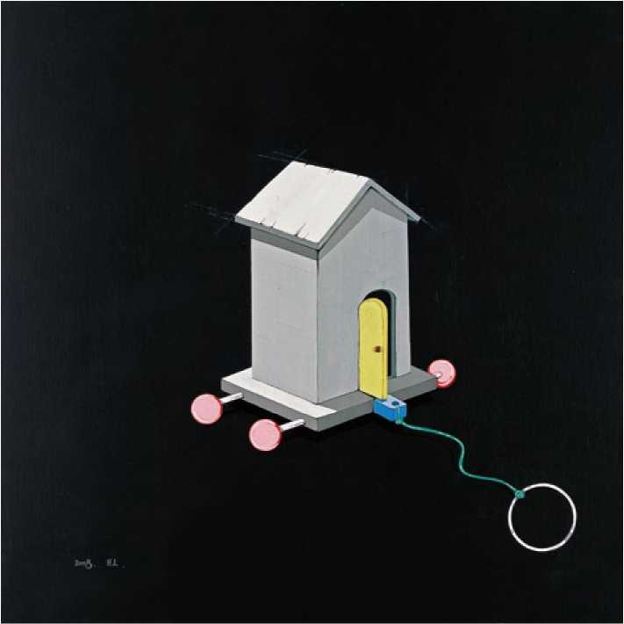
带着房子古流浪
Roving With the House
60 X 60cm
布面综合材料
Mixed media on canvas
2008
55

Slide 29
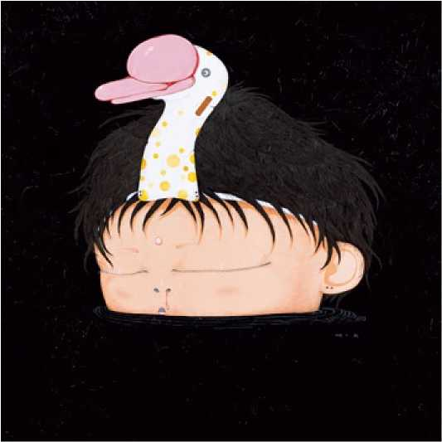
天鹅湖
Swan Lake
1 40 X 1 40cm
布面综合材料
Mixed media on canvas
2008
57

Slide 30
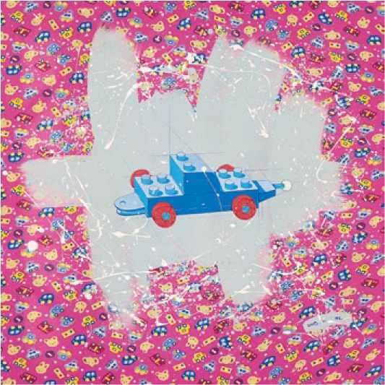
梦里的玩具车
Toy Car i n the Dream
75 X 75cm
布面综合材料
Mixed media on canvas
2008
59

Slide 31
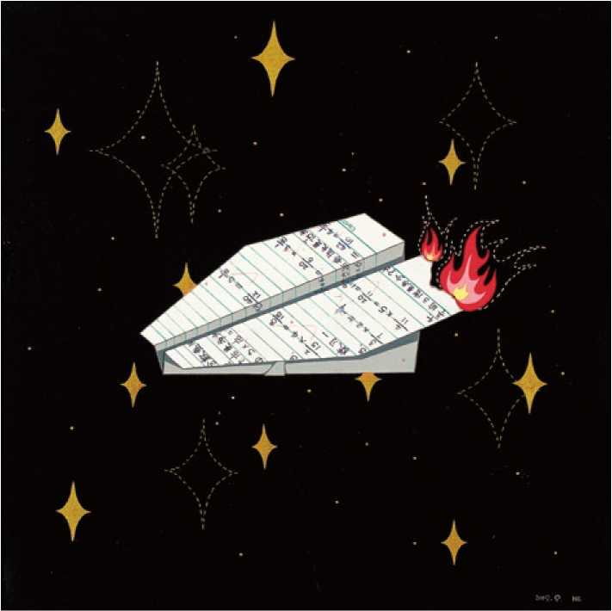
I 燃頰的飞机 I
I The Burning Paper Airplane 丨
I I
I I
I 40 X 40cm I
； 布面综合材料 ；
I Mixed media on canvas |
¹ 2009 ¹
61

Slide 32
提起话文课. 次至几个％珂于不 头疙的。特别是写 作丸真是叫人丈 二亍¹尚損不着诀 肱呀！
作文
Composition
40 X 40cm
布面综合材料
Mixed media on canvas
2009
63

Slide 33
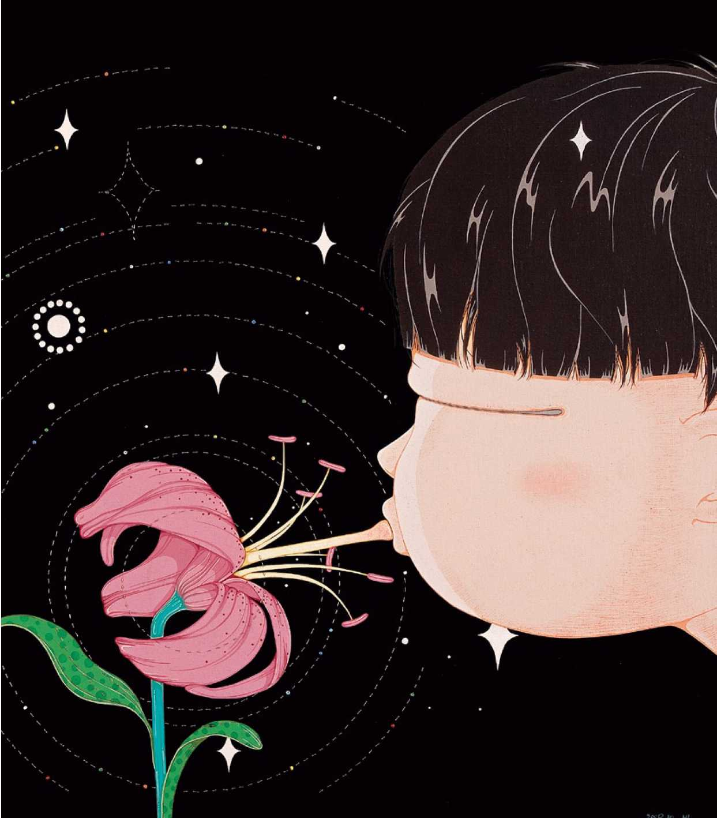
花的姿态
The Delicacy of a Flower
60 X 60cm
布面综合材料
Mixed media on canvas
2009

Slide 34
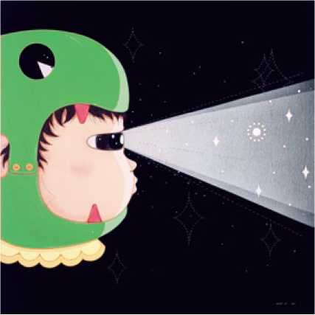
星光
Starlight
60 X 60cm
布面综合材料
Mixed media on canvas
2009
67

Slide 35
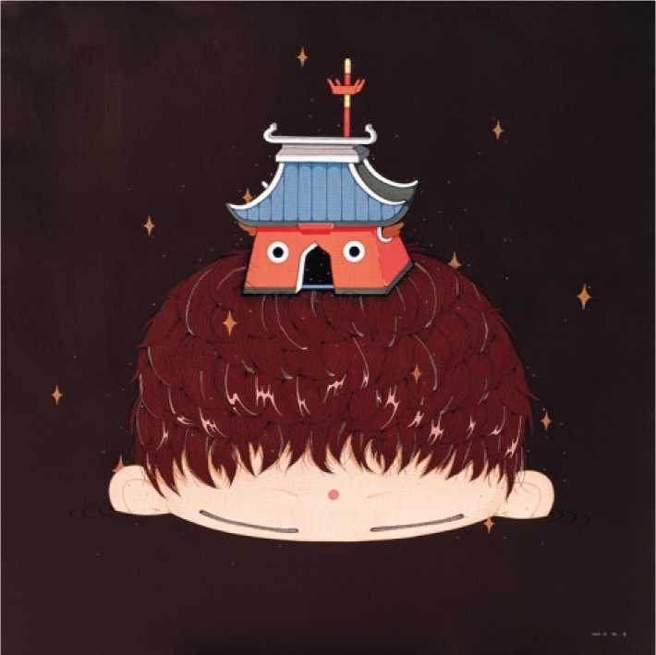
伪装之一
The Guise No. 1
1 00 X 1 00cm
布面综合材料
Mixed media on canvas
2009
69

Slide 36
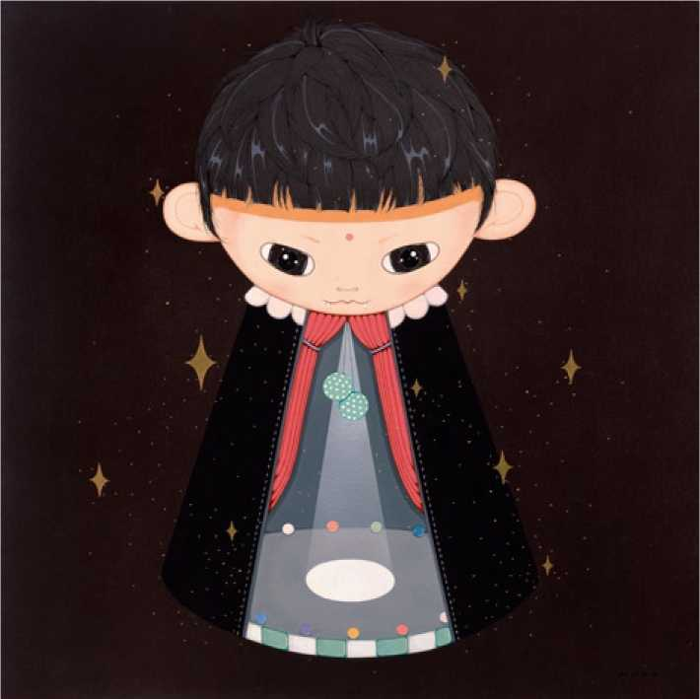
你走了，心里空空的
My Heart Is Empty After You Left
1 00 X 1 00cm
布面综合材料
Mixed media on canvas
2009
71

Slide 37
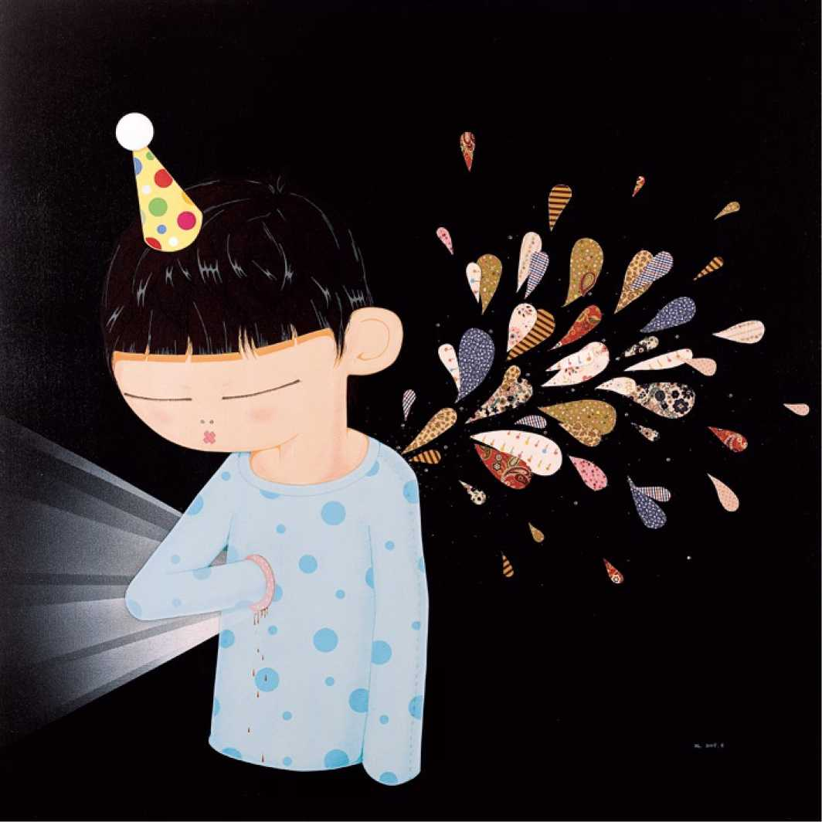
胭火
Fireworks
1 50 X 1 50cm
布面综合材料
Mixed media on canvas
2009
73

Slide 38
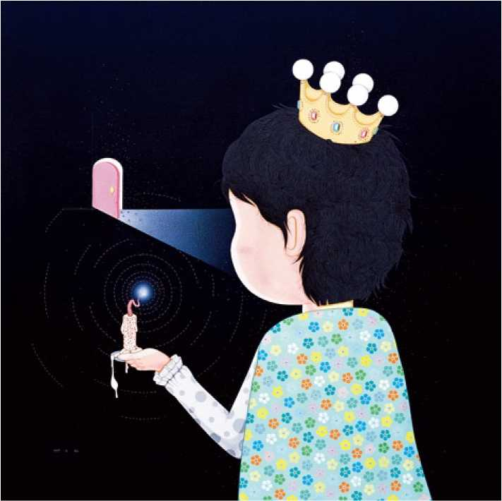
夜里，我这样的寻找
At Night, I Seek Like This
1 50 X 1 50cm
布面综合材料
Mixed media on canvas
2009
75

Slide 39
肖像
Portrait
50 X 50cm
布面综合材料
Mixed media on canvas
2009
77

Slide 40
秘密的花园
The Secret Garden
60 X 60cm
布面综合材料
Mixed media on canvas
2009
79

Slide 41
舌而
The Tongue Kiss
1 50 X 1 50cm
布面综合材料
Mixed media on canvas
2010
81

Slide 42
“救斜赦命! “純;E在。草, 鑫林里伟岀J 口乎赦命声怎 么回事？從叫知零紹恐尤有 雄,小孕救 呷是 如张开血盆大口’把小恐龙 了 “住手矣 ，一米 t身上.汶用.它太夫 了，bi王无用力一电宝 II在石头上.晕了过去
未完待续
T o Be Continue
1 00 X 1 00cm
布面综合材料
Mixed media on canvas
201 1
83

Slide 43
呕吐日
Vomiting Day
1 00 X 1 00cm
布面丙烯
Acrylic o n canvas
201 1
85

Slide 44
爸爸的左肺被切掉了一半
Dad's Left Lung Was Cut i n Half
1 50 X 1 50cm
布面综合材料
Mixed media on canvas
201 1
87

Slide 45
海洋
The Ocean
1 50 X 1 50cm
布面综合材料
Mixed media on canvas
201 1
89

Slide 46
宇宙
The Universe
1 50 X 1 50cm
布面综合材料
Mixed media on canvas
201 1
91

Slide 47
幽灵之二
Ghost No. 2
1 50 X 1 50cm
布面综合材料
Mixed media on canvas
2012
93

Slide 48
初吻
First Kiss
1 00 X 1 00cm
布面综合材料
Mixed media on canvas
2012
95

Slide 49
MR W
1 00 X 1 00cm
布面综合材料
Mixed media on canvas
2013
97

Slide 50
MR B
1 00 X 1 00cm
布面综合材料
Mixed media on canvas
2013
99

Slide 51
Everything I Loved Became Everything I Lost 1 00 X 1 00cm
布面综合材料
Mixed media on canvas
101

Slide 53
艾利克斯的幻想世界之一
The Fantasy World of Alex No . 1 1 70 X 1 20cm
布面综合材料
Mixed media on canvas
2007
105

Slide 54
艾利克斯的幻想世界之二
The Fantasy World of Alex No . 2 1 70 X 1 20cm
布面综合材料
Mixed media on canvas
2007
107

Slide 55
蜡烛的秘密
The Secret of Candle
1 20 X 75cm
布面综合材料
Mixed media on canvas
2007
109

Slide 56
在舞池旋转中想你的心脏
I Miss Your Heart When Gyrating on the Dance Floor 1 70 X 1 20cm
布面综合材料
Mixed media on canvas
2007

Slide 57
生日快乐
Happy Birthday
1 70 X 1 20cm
布面综合材料
Mixed media on canvas
2008
113

Slide 58
我害怕你忘了我
I Am Afraid if You Forget Me
230 X 1 20cm
布面综合材料
Mixed media on canvas
2008
115

Slide 59
他说我看起来爪快乐
He Said I Do Not Look Happy
230 X 1 20cm
布面综合材料
Mixed media on canvas
2008
117

Slide 60
幽灵他爪快乐
The Ghost is Not Happy
1 90 X 1 60cm
布面综合材料
Mixed media on canvas
2008
119

Slide 61
有一天，手心全长出了蘑菇
One Day The Palm Is Overgrown With Mushrooms 1 90 X 1 60cm
布面综合材料
Mixed media on canvas
2008

Slide 62
那些男孩教我的事
The Boys Taught M e Something
300 X 200cm
布面综合材料
Mixed media o n canvas
2008
123

Slide 63
燃頰的房子
The Burning House
60 X 90cm
布面综合材料
Mixed media on canvas
2009
125

Slide 64
金里王子
The Goldfish Prince
1 40 X 200cm
布面综合材料
Mixed media on canvas
2009
127

Slide 65
宝塔糖
The Sugar Pagoda
1 30 X 97cm
布面丙烯
Acrylic o n canvas
201 1
129

Slide 66
魔鬼与我同生
The Devil Lives with Me
1 40 X 1 20cm
布面综合材料
Mixed media on canvas
201 1

Slide 67
性幻想
Sexual Fantasy
1 30 X 97cm
布面综合材料
Mixed media on canvas
2012
133

Slide 68
—个人的圣诞节
Lonely Christmas
1 30 X 97cm
布面综合材料
Mixed media on canvas
2012

Slide 69
Ong
Hundred y
百年的孤独
^{ear}s of
SoJitude
 | 2^{00x}100_{Crn} 市面综合材料
Mixed | media o_{n} ^{on c}anvas 2012
137

Slide 70
潜流
The Underflow
1 20 X 1 40cm
布面综合材料
Mixed media on canvas
2012
139

Slide 71
雪山
Snow Mountain
40 X 1 00cm
布面综合材料
Mixed media on canvas
2012
1 41

Slide 72
木
Wood
40 X 1 00cm
布面综合材料
Mixed media on canvas
2012
1 43

Slide 73
适合哭泣的场台之一
The Occasion for Cry No.1
40 X 1 00cm
布面丙烯
Acrylic o n canvas
2013
适合哭泣的场台之二
The Occasion for Cry No.2
40 X 1 00cm
布面丙烯
Acrylic o n canvas
2013
适合哭泣的场台之三
The Occasion for Cry No.3
40 X 1 00cm
布面丙烯
Acrylic o n canvas
2013
145

Slide 74
—个人的战斗
The Battle of Oneself
1 40 X 300cm
布面丙烯
Acrylic o n canvas
2013
1 47

Slide 76
郝朗
201 1 研究生毕业于四川美术学院油画系
2007 毕业于重庆四川美术学院油画系
2006 作为交换留学生就读于新加坡新航艺术学院
个展
2013 初吻，玉兰堂画廊，北京
201 1 如果你发现什么秘密，不要告诉任何人，」画廊，上海
2009 与天街一起梦想，龙湖地产，重庆
2008 我害怕你忘了我，器・Haus空®,重庆
2006 上，新航艺术学院，新加坡
群展
2013 艺术北京，全国农业展览馆，北京
2013 十畫——2013青年艺术邀请展，佳應安善美术馆，重庆
2012 第五届中国国际青年艺术周，梯级艺术中心，北京
2012 亮点——中国青年艺术绘画展，18画廊，上海
201 2 1 02当代艺术展，黄桷坪美术馆，重庆
2012 草场地五冃艺术节——"记忆催眠”实验影像展，草场地，北京
2012 中艺博国际画廊博览会，国际贸易中心，北京
2012 艺术北京，全国农业展览馆，北京
2012 "n度视觉”图像学与汽车的偶遇，重庆两江幸福广场，重庆
2012 重庆时尚之夜，国际时尚发布中心，重庆
201 1 微观精神——四川美术学院青年新绘画展，华氏画廊，上海
201 1 边界效应，空港十号画廊，成都
201 1 未知，J画廊，上海美干山

Slide 77
2010 WOW艺术展，银奈商场，杭州
2010 艺术+生活，尚元艺术基地，重庆
2010 视窗——当代艺术衍生作品展，廊桥艺术空间，成都
2010 保时捷溢彩心，重庆美术馆，重庆
2009 创意成都，成都
2009 平台，坦克库当代艺术中心，重庆
2009 两小有猜，感觉艺术空间，重庆
2009 风华重现，升艺术空间，上海
2009 "不有”实验艺术聚会，751动力广场，北京
2009 闪开！今天我们八零后——炫目！玉兰堂画廊，北京
2008 梦旅人，坦克库代艺术中心，重庆
2008 中国当代影像艺术展，Trieste Contemporanea，意大利
2008 Vital第二届重庆国际现场艺术节，械空间，重庆
2008 格差•现实当代艺术邀请展，红坊美术馆，上海
2008 快城快客2008上海双年展特别邀请展——川美年轻态，徐汇艺术馆，上海
2008 漂浮的风景，K画廊，成都
2007 Vital国际行为艺术节，曼切斯特，英国
2007 一分钟影像节，根特，比利时
2007 宋庄制造II，上上美术馆，北京
2007 "黄漂”漂进美术馆，重庆美术馆，重庆
2007 第31届威特史丹特露天电影节，威特史丹特，德国
2007 501艺术周——0行动•行为计划，零号空间，重庆
2007 石涅• COAL展——大型装置展及现代舞表演，器・Haus空间，重庆
2007 798艺术节独立単元展之影像単元：八美涂——新生代学院影像报告，洞房咖啡，北京
2007 退色——现代舞表演，器・Haus空间，重庆
2007 Vital国际行为艺术节——华人艺术盛会，501艺术基地，重庆
2006 一分钟——青年艺术家实验影像艺术展，坦克库当代艺术中心，重庆
2006 朴实的影像摄影作品展，新航艺术学院，新加坡
Hao Lang
2011 Graduated from the Oil Painting Department of Sichuan Fine Art Institute
as a post graduate
2007 Graduated from the Oil Painting Department of Sichuan Fine Art Institute
2006 Study in Lasalle — SIA College of the Arts (Singapore) as an exchange student
Solo Exhibitions
2013 First Kiss, Line Gallery, Beijing
2011 If You Find A Secret, Don't Tell Anyone! J Gallery, Shanghai
2009 Dream Together With the Paradise Walk， Longfor Real Estate，Chongqing
2008 I Am Afraid if you Forget Me，Organ • Haus Art Space，Chongqing
2006 Up，Lasalle — SIA College of the Arts, Singapore
Group Exhibitions
2013 Art Beijing, National Agricultural Exhibition Center, Beijing
2013 Paintings of Ten Years： 2013 Invitational Exhibition of Youth Art，
Jia Xiang An Shan Art Museum, Chongqing
2012 The Fifth China International Youth Arts Festival，T Art Center，Beijing
2012 Spot Light, China Youth Art Exhibition, Bund 18, Shanghai
2012 102 Contemporary Art Exhibition，
Huang Jueping Contemporary Art Gallery，Chongqing
2012 Annual May CCD Festival — "Hypnosis of Memory" Experimental Film/video Exhibition，Caochangdi，Beijing
2012 China International Gallery Exposition, International Trade Center, Beijing
2012 Art Beijing, National Agricultural Exhibition Center, Beijing
2012 "n vision" — An Encounter of Image And Car，

Slide 78
Liangjiang Happiness Square, Chongqing
2007 Made in SongzhuangH, Sunshine Museum, Beijing
2007 Enduring Infatuation, Chongqing Museum of Art, Chongqing
2007 31. Open-Air Filmfest Weiterstadt, Germany
2007 501 Art Week — 0 Action - Performance Plan,ZERO Space, Chongqing
2007 COAL — Installation and Modern Dance Exhibition,
Organ - Haus Art Space, Chongqing
2007 Unit Exhibition of 798 Art Festival — Video Report of New Generation, DONGFANG Coffee, Beijing
2007 Figment of Pigment,Organ - Haus Art Space,Chongqing
2007 Vital International Chinese Live Art Festival, 501 Art Base, Chongqing
2006 The One Minutes Workshop, Tank Loft Contemporary Art Center, Chongqing
2006 Discreet Images, Lasalle — SIA College of the Arts, Singapore
2012 Chongqing Fashion Night,International Fashion Center, Chongqing
2011 Micro Spirit — New Painting Exhibition of Sichuan Fine Art Institute Young Artists， hwas Gallery, Shanghai
2011 Boundary Effect，Airport 10 Gallery, Chengdu
2011 Unknown, J Gallery, Shanghai
2010 WOW Art Exhibition，Yintai Shopping Mall, Hangzhou
2010 Art + Life，Shangyuan Art Base，Chongqing
2010 Windows: Exhibition of Contemporary Art Derivative Works,
Lang Bridge Art Space, Chengdu
2010 Porsche: Empowering The Future, Chongqing Art Museum, Chongqing
2009 Creative Chengdu，Chengdu
2009 Platform，Tank Loft Art Center，Chongqing
2009 Melody Fair, Sensation Art Space, Chongqing
2009 Reproduction of Beauty，SHiNE Art Space, Shanghai
2009 NON-BEING Experimental Art Party, 751 Dynamic Square，Beijing
2009 "Hey! We're 80s — Dazzling" Group Exhibition of Young Artists,
Line Gallery, Beijing
2008 The Dreamers,Tank Loft Art Center,Chongqing
2008 China Contemporary Video Art Exhibition,Trieste Contemporanea, Italy
2008 Vital International Chinese Live Art Festival, Xie Art Space, Chongqing
2008 Difference - Reality of Invitational Contemporary Art Exhibition,
Red Town Art Museum, Shanghai
2008 Trans Local Motion： 7th Shanghai Biennale — Special exhibition：
Young Spirits in Sichuan Fine Arts Institute, Xuhui Art museum, Shanghai
2008 Floating Scenery, K. Gallery, Chengdu
2007 Vital International Chinese Live Art Festival, Manchester, UK
2007 The One Minute, Ghent, Belgium

Slide 79
出品：玉兰堂
Presented by LINE GALLERY
编辑：李鹏飞，杨哲
Editor： Li Pengfei, Amanda Yang
撰文:郝朗
Author: Hao Lang
翻译：史宁，杨哲
Translator: Shi Ning， Amanda Yang
设计：乐天
Designer: Heather
2013年印刷于北京
Printed in Beijing, China, 2013
生=
玉蘭堂畫廊LINE GALLERY
北京市朝陽區酒仙橋路2號院798東街
798 East Street, No.2 Jiuxianqiao Road., Chaoyang District., Beijing 100015 電話/傳真 Tel/Fax: +8610-59789916
電子聲箱 E-mail: art@line-gallery.com 網址 www.line-gallery.com

